Slide 1

National Emergency Laparotomy Audit
The 6th report
Please edit/delete slides for your own local use as required; these slides aim to support local teams in presenting their own data to multidisciplinary teams

Slide 2
INSTRUCTIONS FOR USE
This slide-set was designed to be modified for presentation of local NELA data to facilitate local QI work
Local NELA data is available to all with administrator privileges, via data.nela.org.uk
Locations for entry of local NELA data in this slide-set can be identified by searching ‘xx’
Locations for AHSN regional data in this slide-set can be identified by searching for ‘yy’
Local and regional data can be found in the Year 6 Annual RAG table: https://www.nela.org.uk/Sixth-Patient-Report#pt. The relevant column in this table for this data is shown in the notes part for each slide
To view the notes part below each slide – click on ‘View’ tab and select ‘Normal’
Notes:
Instruction slide

Slide 3
RAG ratings
NELA uses the following key to allocate a RAG rating for the proportion of patients for which each process of care was met:
Green 85–100% - this has increased from 80% for ALL metrics this year*
Amber 55–84%
Red 0–54%
Grey Data unavailable
*This means there may appear to have been a fall in the quality of care by RAG rating although in some cases the number may have been improved from last year.
In the subsequent tables, it is helpful to “fill” the cell with the relevant colour to show the level of achievement.
Notes:
Instruction slide

Slide 4
Index of slides (search xx or yy to find where your local/regional data needs to be inputted)
Introduction: 2-8
Preoperative care: 9-21
Intraoperative care: 22-27
Postoperative care: 28-30
Outcomes: 31-39
Care of the older patient: 40-46
NELA Recommendations: 47-48
NELA Impact and Communications: 49-51

Slide 5
Introduction

Slide 6



6th NELA report: 24,823 patients
6th Report published November 2020
Notes:
Largest dataset about emergency laparotomy patients in the world

Slide 7
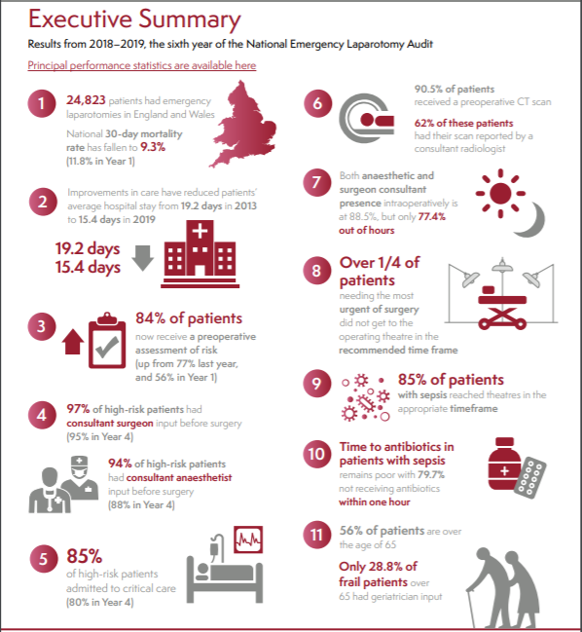
Notes:
Achievements across all areas reviewed, although many improvements still required
Mortality has plateaued, changes maybe slowing down.
Trouble areas – frailty, sepsis, critical care

Slide 8
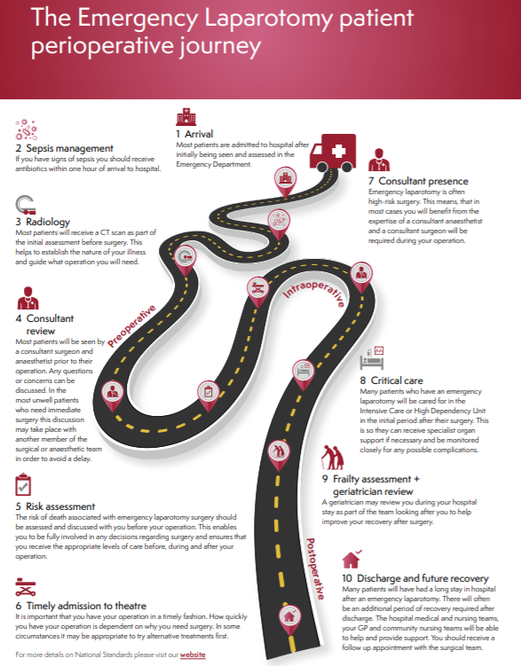

Slide 9
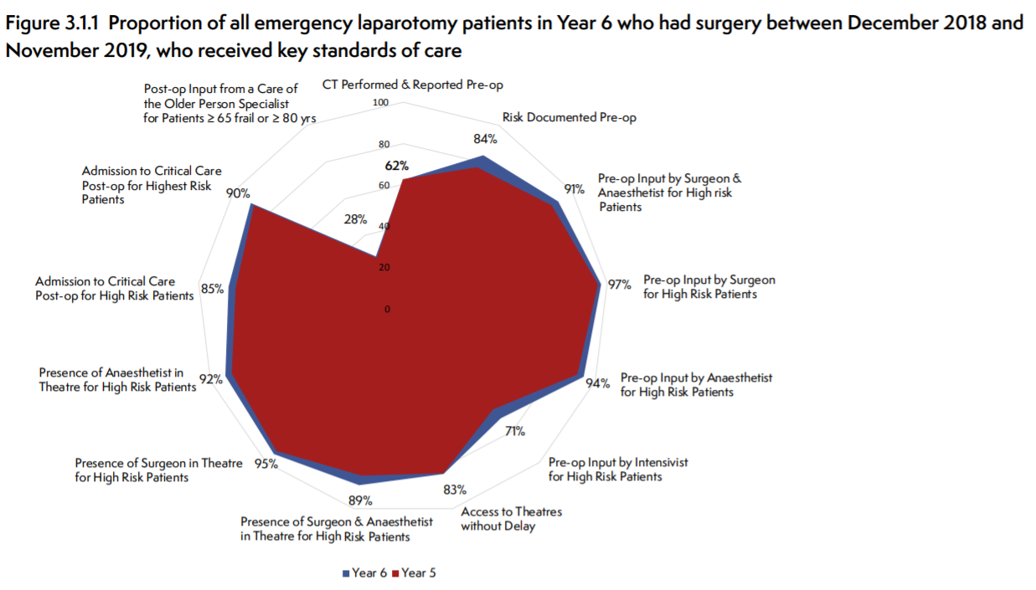
6th NELA report – the key standards
Notes:
Key standards are grouped into
Preoperative assessment – including consultant review of patients and preoperative CT scanning and risk assessment before surgery
Timely access to theatres
Consultant presence in theatres
Admission to critical care
Geriatric perioperative involvement
This radar plot graphically shows the proportions of ALL patients in year 6 who met each of the standards & clearly shows which areas (geriatrics) requires more work nationally

Slide 10
Case Ascertainment: National
179 hospitals were included in this metric. Overall case ascertainment was 84.5% (increased from year 5, 84.0%). Overall 121 hospitals were rated green and 20 were red.
National case ascertainment – 84.5%

Slide 11
Case Ascertainment: Local
179 hospitals were included in this metric. Overall case ascertainment was 84.5% (increased from year 5, 84.0%). Overall 121 hospitals were rated green and 20 were red.
National case ascertainment – 84.5%
Local case ascertainment – XX%
Regional case ascertainment = YY %
Notes:
Data source = year 6 annual RAG data column S
It may be useful to colour the text boxes according to RAG rating

Slide 12
Preoperative Care

Slide 13
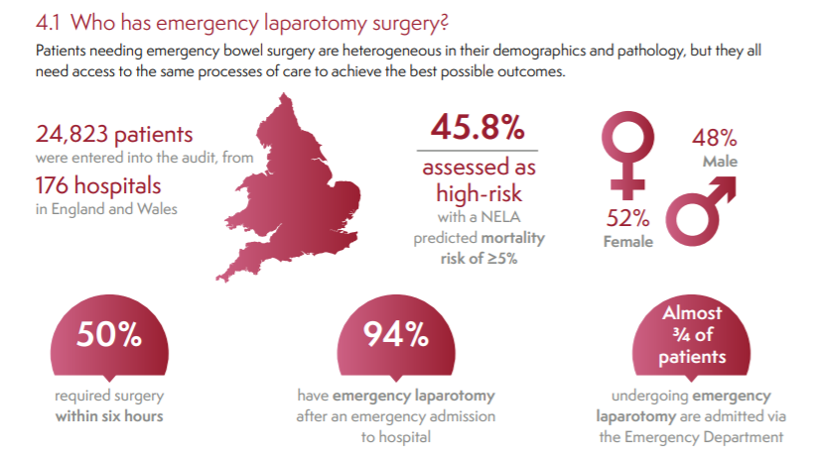

Slide 14
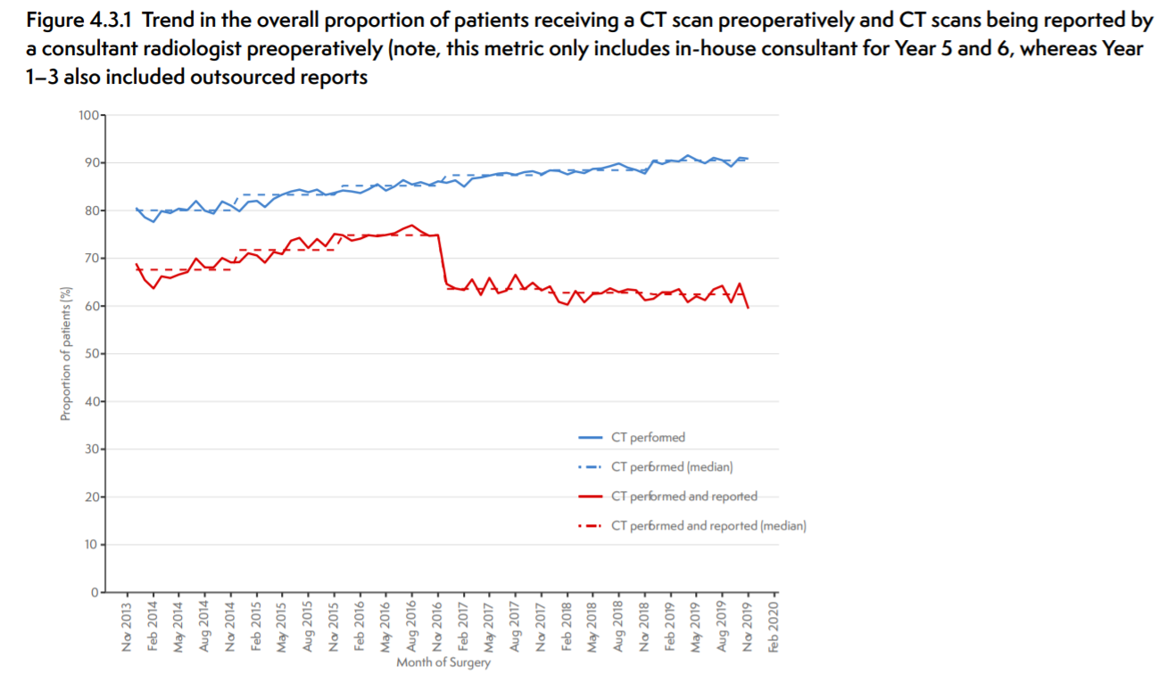
CT Reported before Surgery: National
Nationally:
90.5% patients have a preoperative CT scan
62.3% have a CT reported before surgery
Notes:
These national results in amber, reflect the national mean reported number of scans for all CT scans performed
90.5% patients have a CT scan before surgery compared with 80% in year 1.
62% of patients had a CT scan which was reported by an in-house consultant radiologist before surgery
45.2% of patients had a CT scan performed and had discussion between radiologist and the requesting team

Slide 15
CT reported before Surgery: Local
Nationally:
90.5% patients have a preoperative CT scan
62.3% have a CT reported before surgery
Local results = XX %
Regional results = YY %
Notes:
Local data = year 6 annual RAG data column V

Slide 16
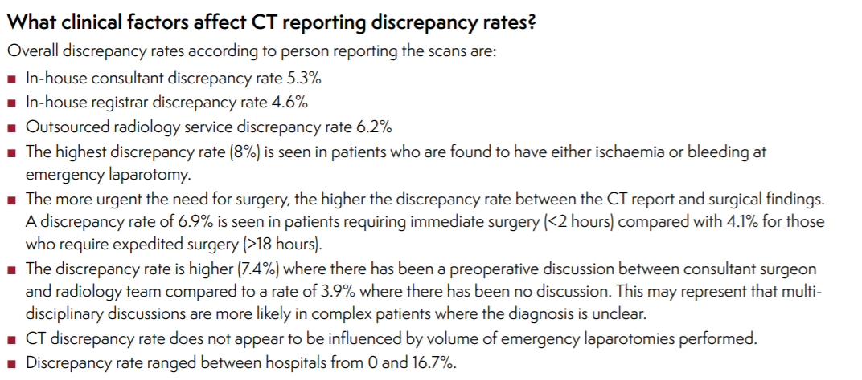
CT Discrepancy Rates: National
Accepted discrepancy rates from the Royal College of Radiologists’ standards should be less than 5% regardless of who reports the scan. For the purposes of NELA, a discrepancy is described as a difference between the CT report and the surgical findings that altered or delayed the diagnosis or surgical management.
Overall discrepancy rate = 5.5%

Slide 17
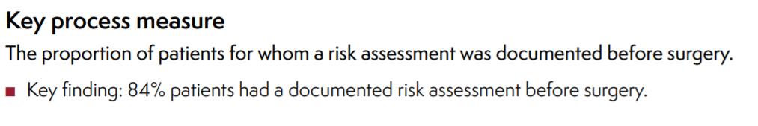
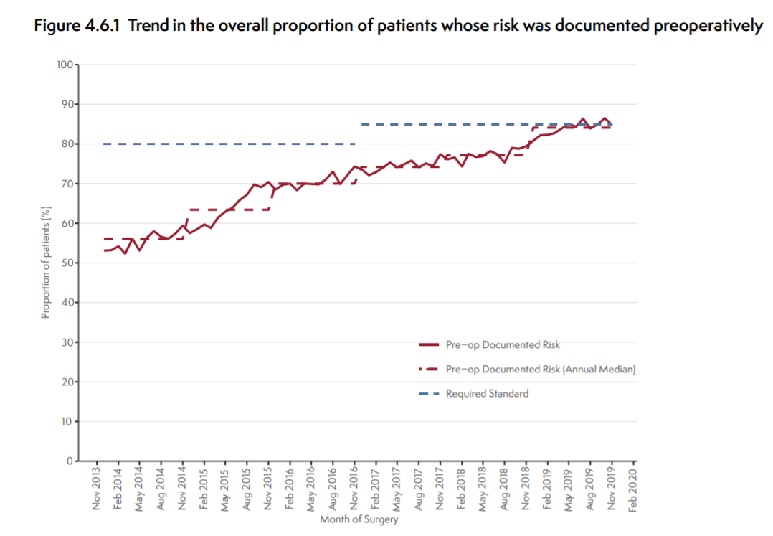
Preop Risk Assessment: National

Slide 18
Preop Risk Assessment: Local
Local preoperative risk assessment = XX%
Regional preoperative risk assessment = YY%
Notes:
Data source = year 6 annual RAG data column AF

Slide 19
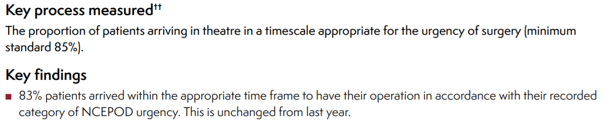
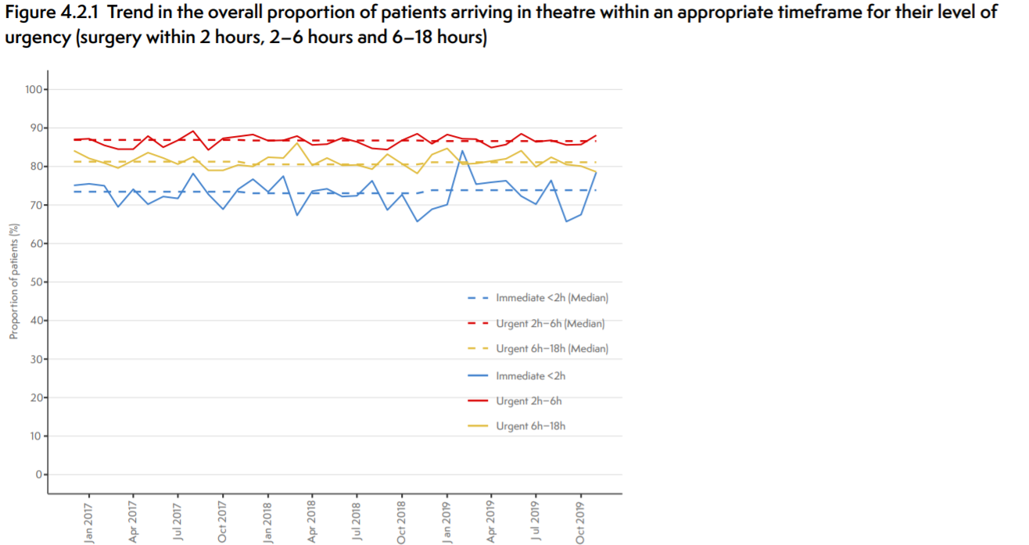
Arrival to Theatre: National
National arrival in a timescale appropriate to surgery = 83%
Notes:
34% of patients experience delay if a decision is made for immediate surgery in the morning 0800–1200 compared to only 19.3% between midnight–0800

Slide 20
Arrival to Theatre: local
National arrival in a timescale appropriate to surgery = 83%
Local hospital arrival in a timescale appropriate to surgery = XX%
Regional = YY%
Notes:
Data source = year 6 annual RAG data column AK

Slide 21
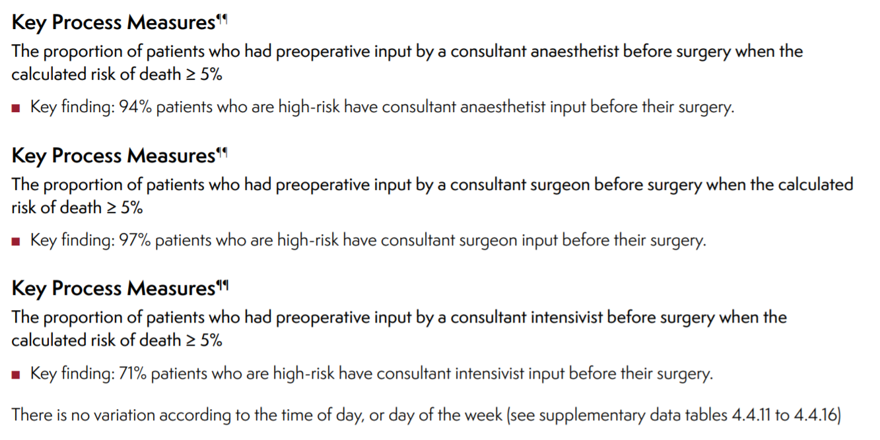
Preop Consultant Input: National

Slide 22
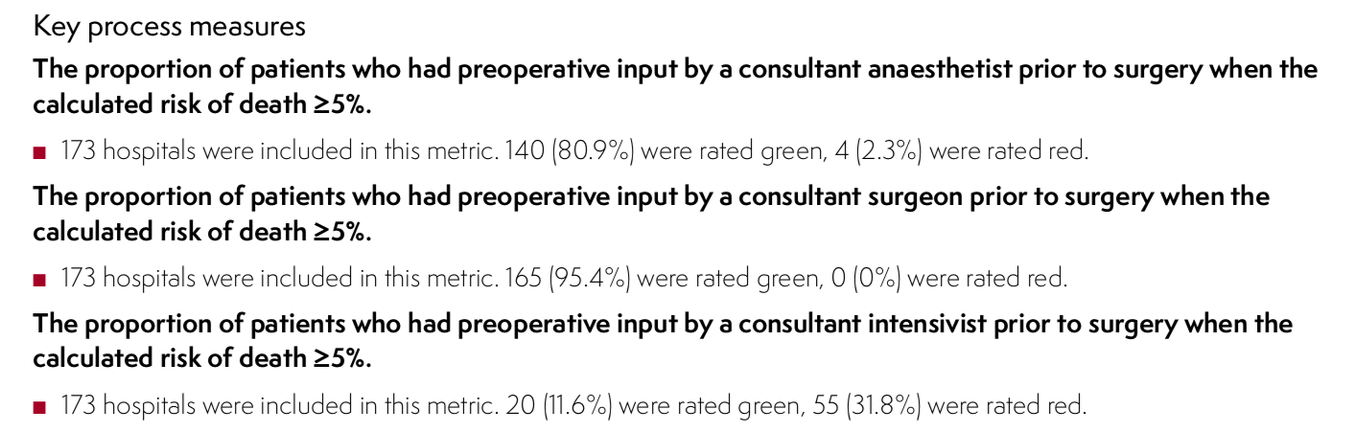
Preop Consultant Input: Local
 | National | Local | Regional
Surgeon | 96.9% | XX | YY
Anaesthetist | 93.9% | XX | YY
Both | 91.4% | XX | YY
Intensivist (risk>10%) | 76.9% | XX | YY
Notes:
Data source = year 6 annual RAG data column AP, AU, AZ, BE

Slide 23
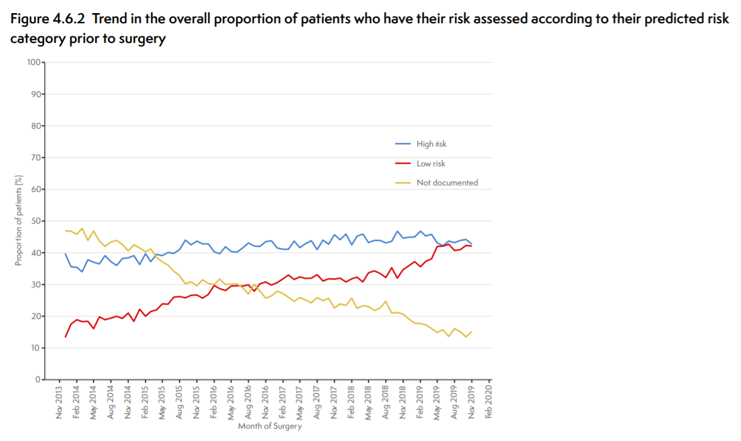
Risk assessments performed according to predicted risk category

Slide 24
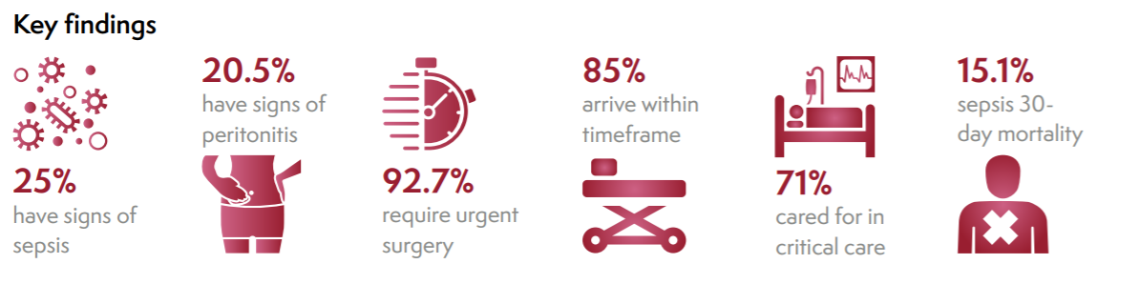
Antibiotics in Suspected Sepsis
Only 20.3% of suspected sepsis cases received antibiotics within one hour from admission
Antibiotics were administered on average 24.2 hours after admission in those with suspected sepsis

Slide 25
Intraoperative Care

Slide 26
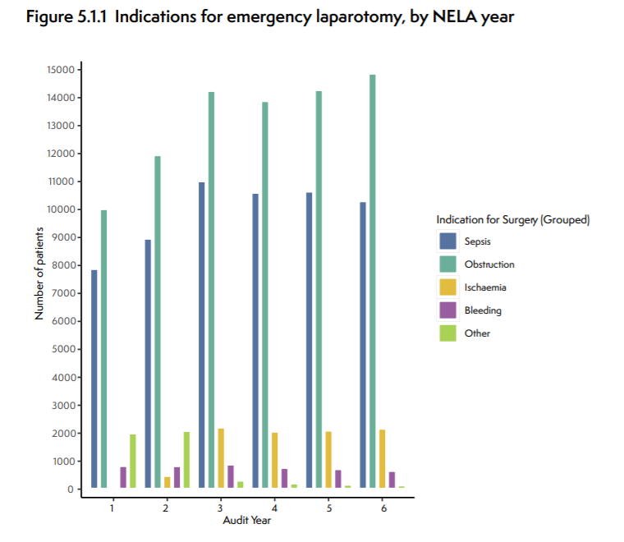
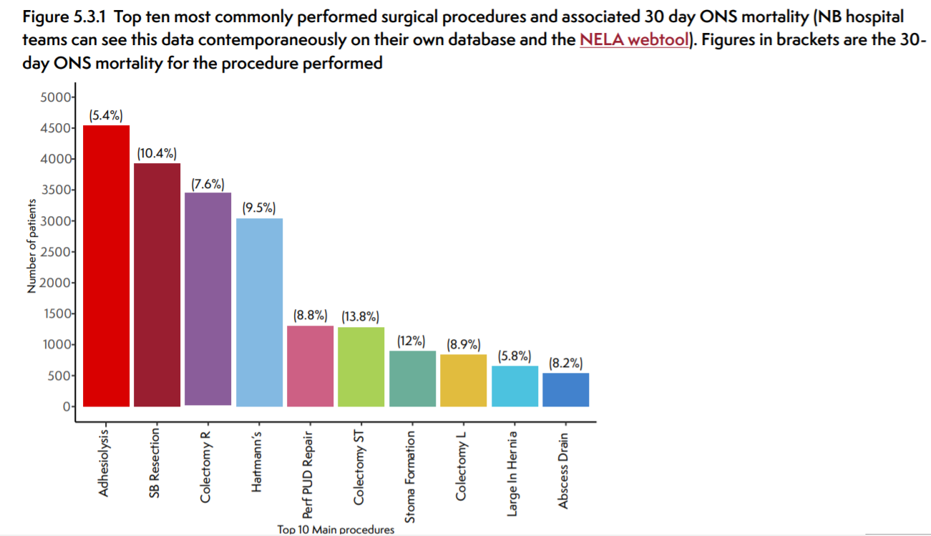
Indications for Emergency Laparotomy
Notes:
Find your own data on the webtool
Majority operations are for obstruction or abdominal infection.
Highest mortality is for ischaemia and bleeding – and they're most likely to have consultant presence. These patients are also the most likely to get to theatre in appropriate time frame (87.2% bleeding, 87.6% ischaemia)

Slide 27
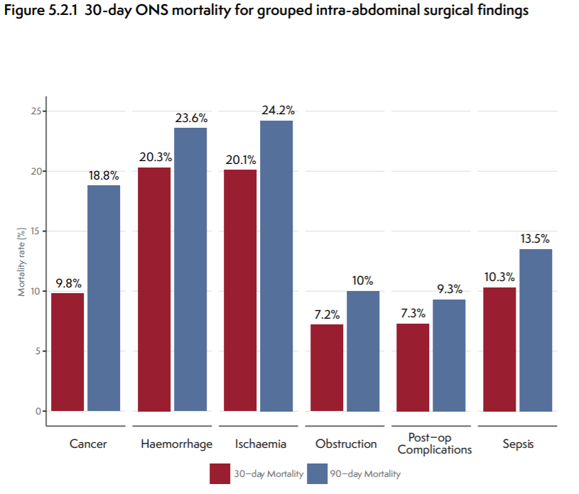
Mortality by Intra-abdominal Surgical Findings

Slide 28
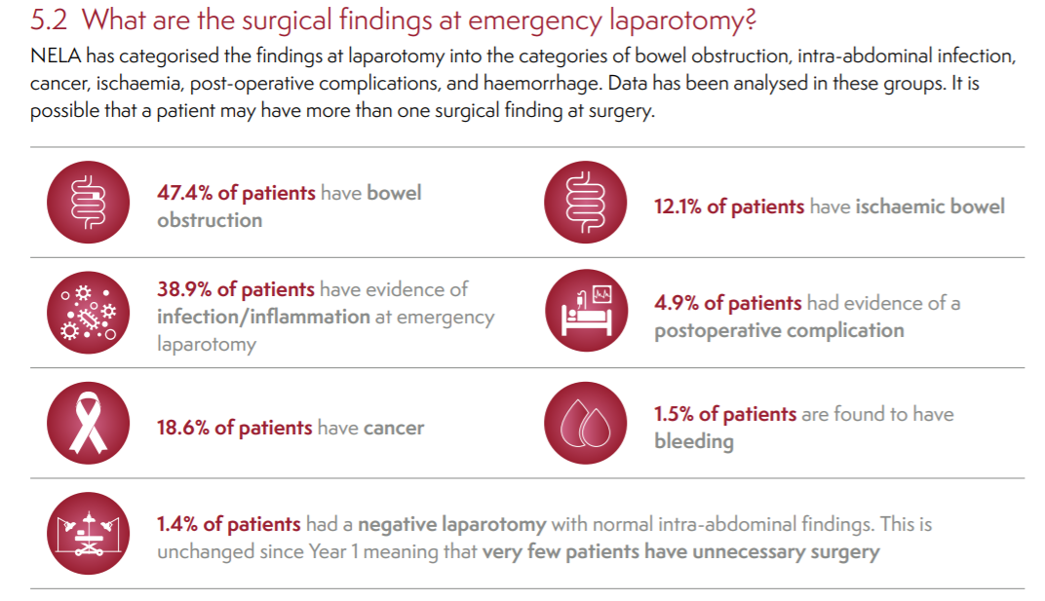
Surgical findings

Slide 29
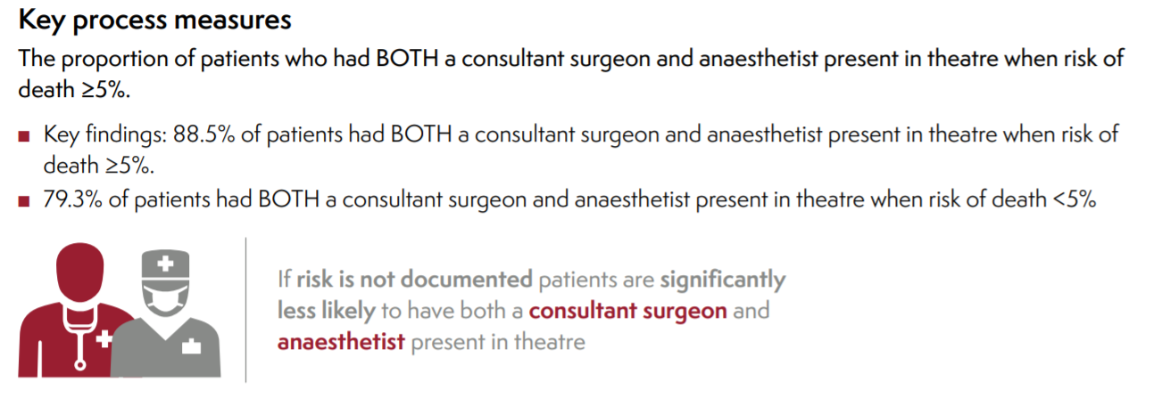
Consultant Presence In Theatres: National

Slide 30
Consultant Presence In Theatres: local
 | National | Local | Regional
Surgeon | 94.8% | XX | yy
Anaesthetist | 92.3% | XX | yy
Both | 88.5% | XX | YY
Notes:
Data source = year 6 annual RAG data column BO, BT, BY

Slide 31
Postoperative Care

Slide 32
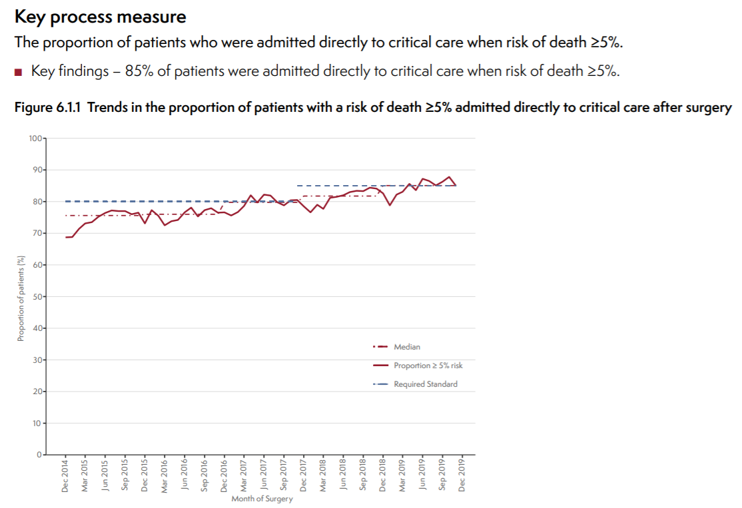
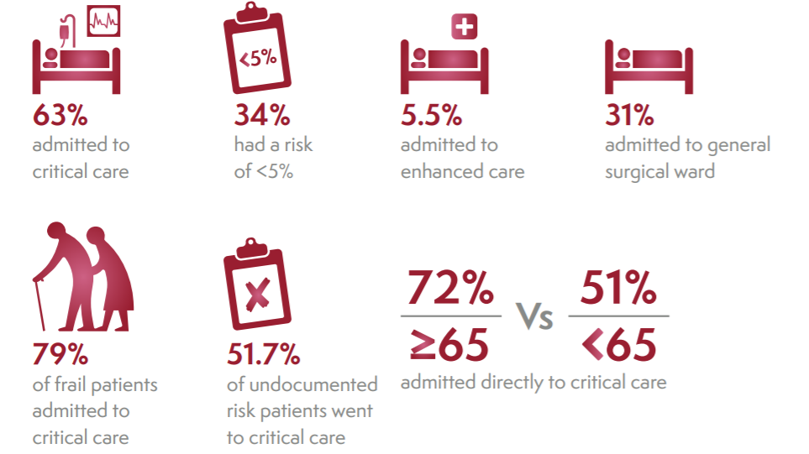
Post op Critical Care: National

Slide 33
Post op Critical Care: Local
 | National | Local | Regional
Admission if risk >5% | 85.2% | XX | YY
Notes:
Data source = year 6 annual RAG data column CD

Slide 34
Outcomes

Slide 35
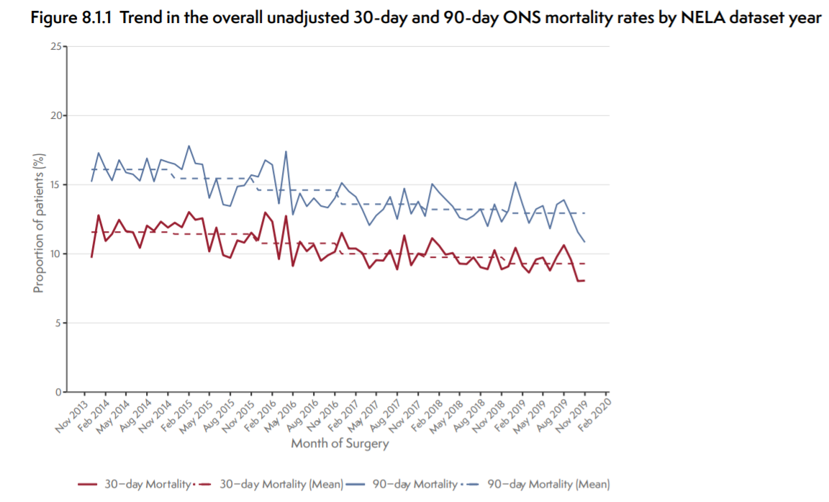
Mortality: National
Notes:
Trend has fallen over the 5 years of reporting from 11.8% in year 1

Slide 36
Mortality: Local
Local 30 day risk adjusted mortality = XX %
Notes:
Local data = year 6 annual RAG data column H
Trend has fallen over the 5 years of reporting from 11.8% in year 1

Slide 37
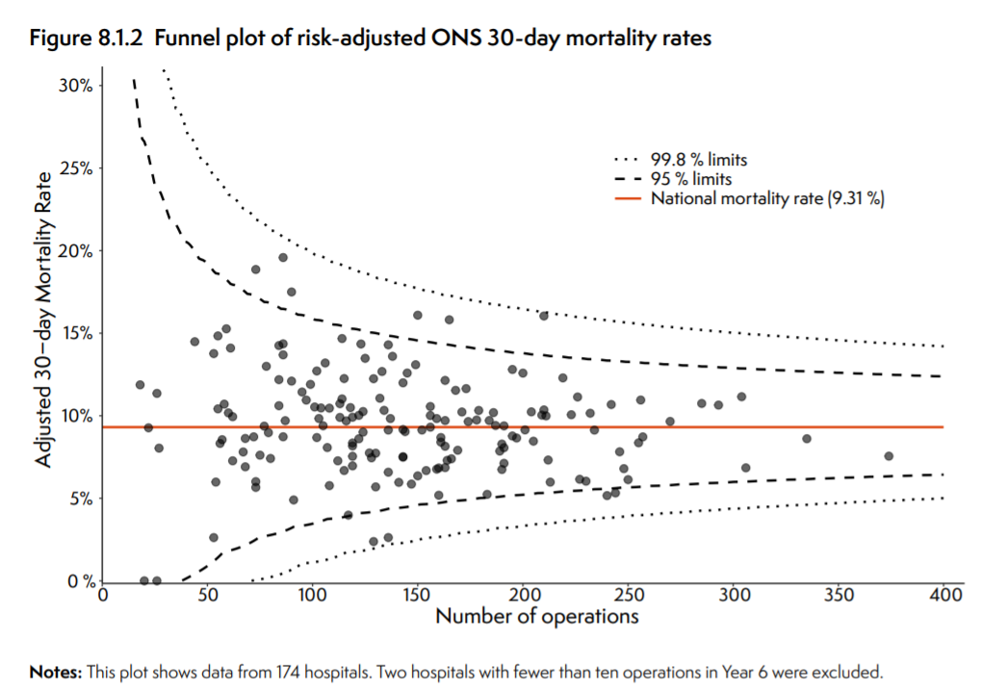
Funnel Plot of risk adjusted ONS 30-day mortality

Slide 38
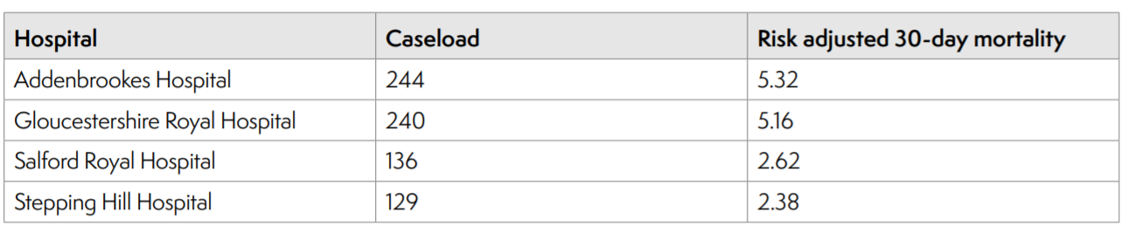
Hospitals with the lowest 30-day mortality

Slide 39
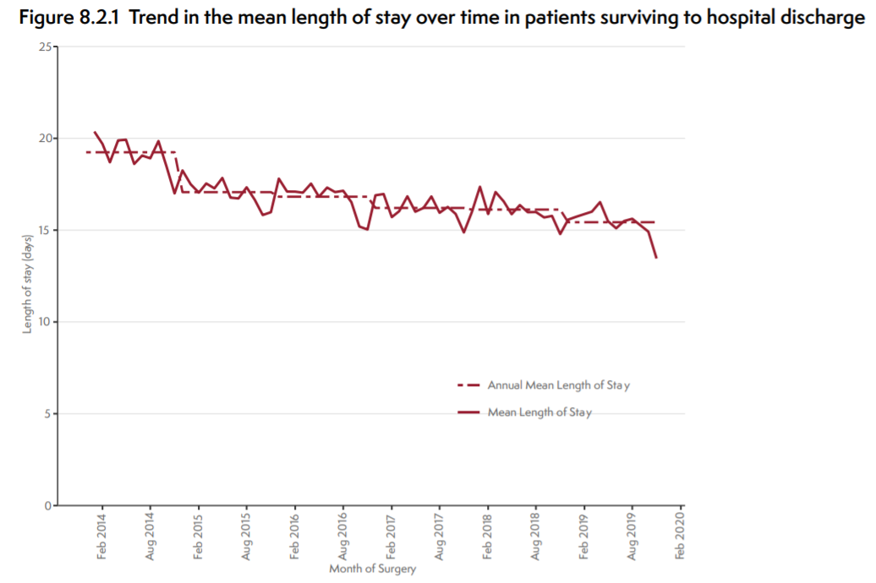
Length of Stay: National
National LoS = 15.4 days
Notes:
Data source = year 6 annual RAG data column DJ

Slide 40
Length of Stay: Local
National LoS = 15.4 days
Local LoS = XX days
Notes:
Local LoS data source = year 6 annual RAG data column DJ

Slide 41
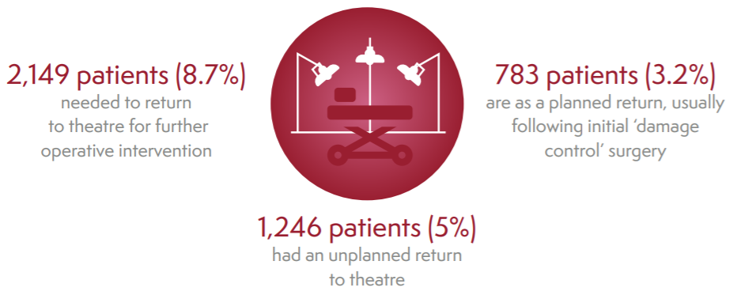
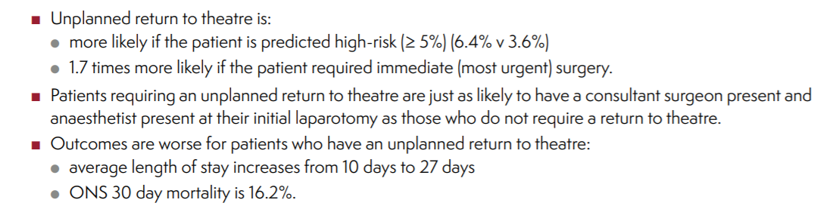
Unplanned Events - Return to theatre
Notes:
Local data = year 6 annual RAG data column CV

Slide 42
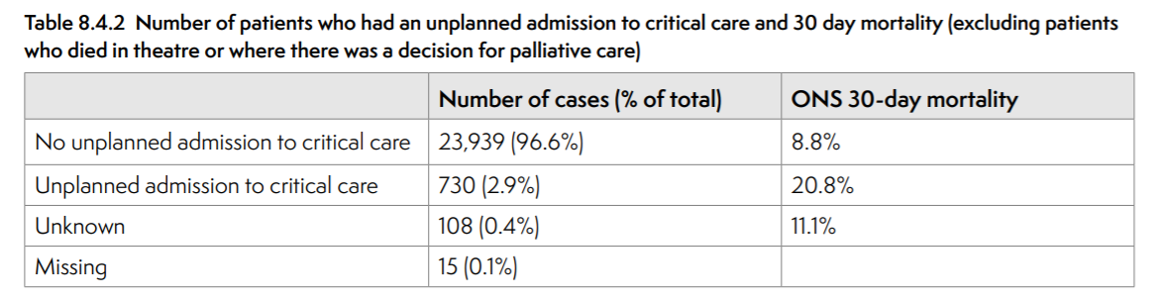
Unplanned admission to critical care
Notes:
Local data = year 6 annual RAG data column DA

Slide 43
Care of the Older Patient

Slide 44
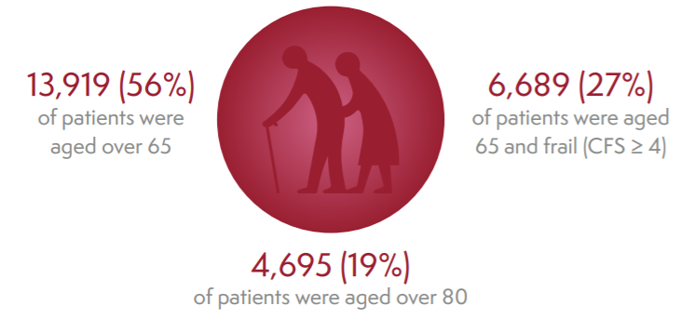
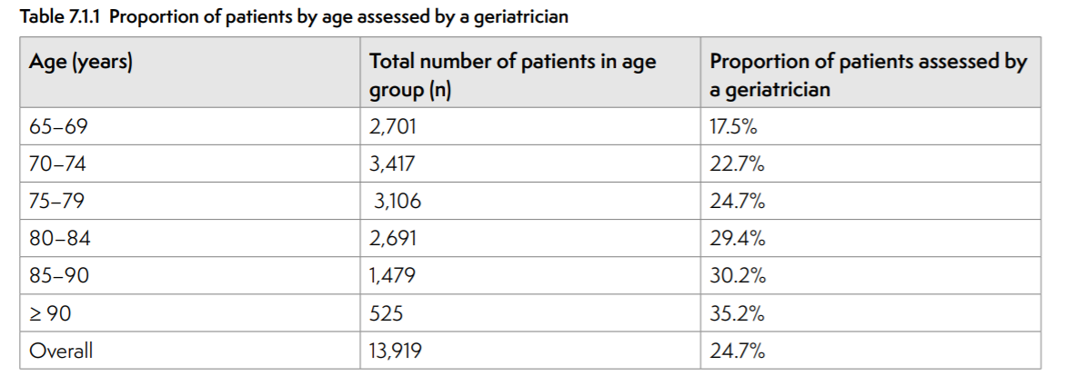
Geriatric and frailty - National
Notes:
Local data = year 6 annual RAG data column CR

Slide 45
Geriatric and frailty - Local
Local geriatric reviews (proportion of patients) = XX%
Regional = YY%
Notes:
Local data = year 6 annual RAG data column CR

Slide 46
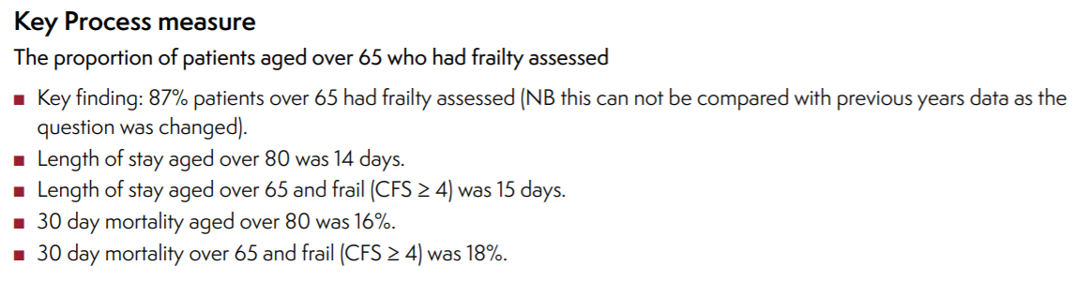
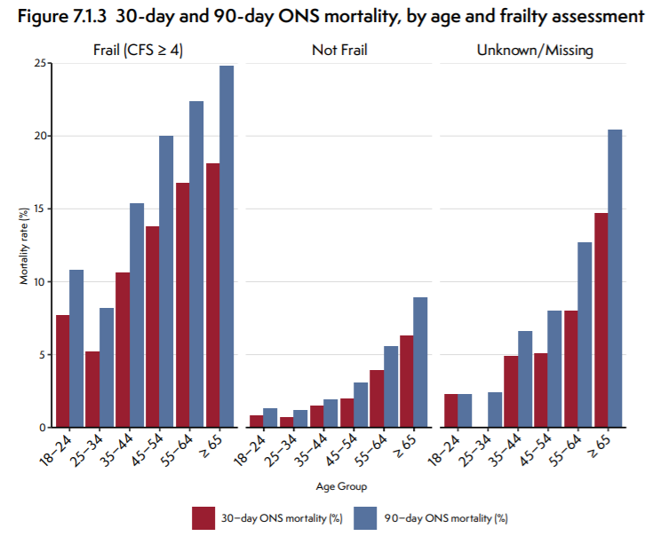
Assessment of frailty - National

Slide 47
Assessment of frailty - National
Local assessment of frailty in those aged over 65:
XX%
Notes:
Local assessment of frailty for those aged over 65: this information must be pulled from your hospital’s data in the NELA webtool. Please filter the data to match that in this report (1 Dec 2018 – 30 Nov 2019), then filter for those aged 65+, and then filter on frailty score

Slide 48
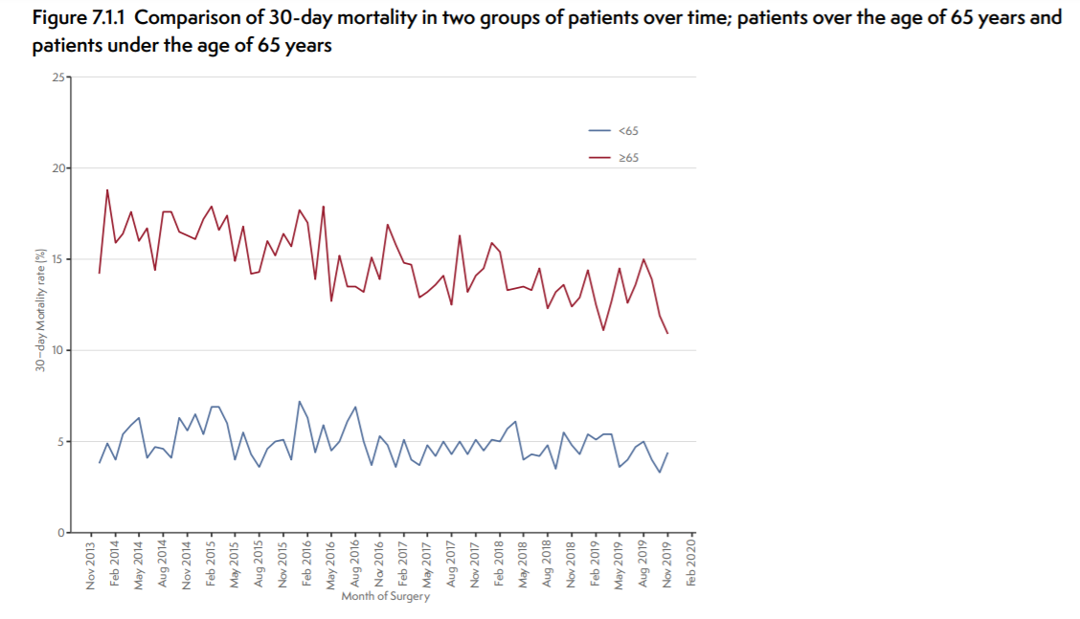
Mortality – National (patients over 65)

Slide 49
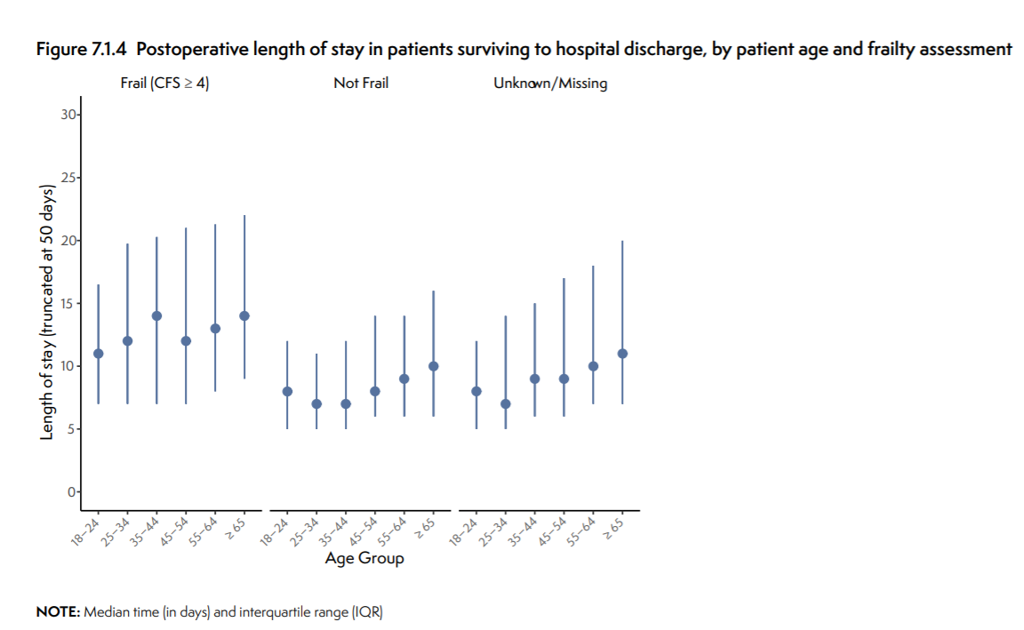
LoS – National (patients over 65)

Slide 50
NELA Recommendations

Slide 51
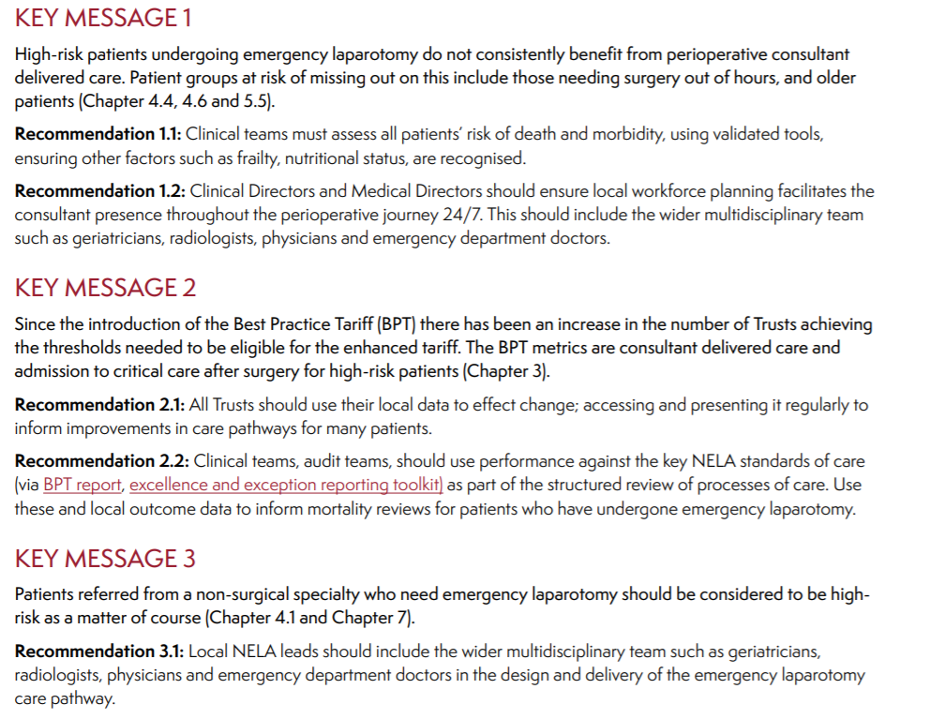
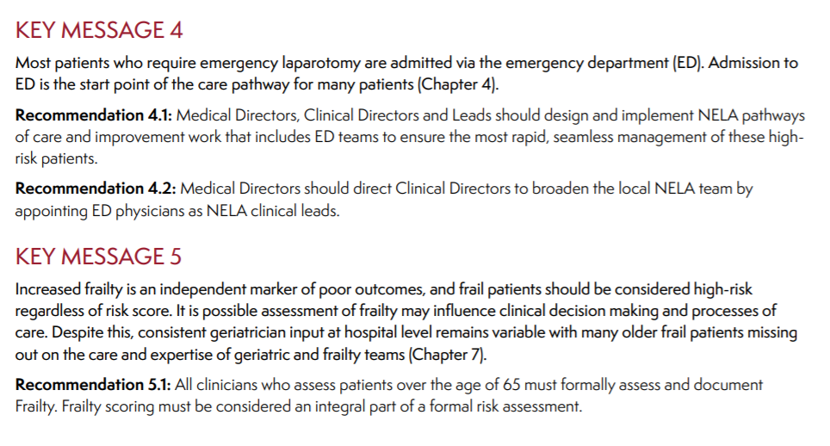
The Recommendations

Slide 52
NELA Impact and Communications

Slide 53

NELA Impact

Slide 54
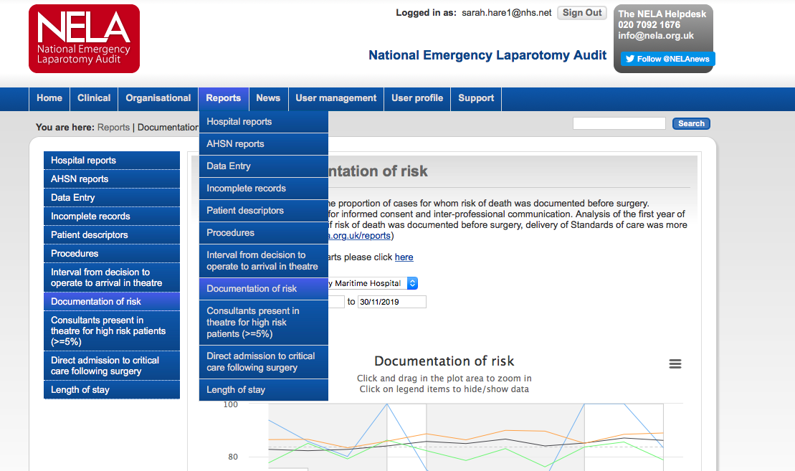
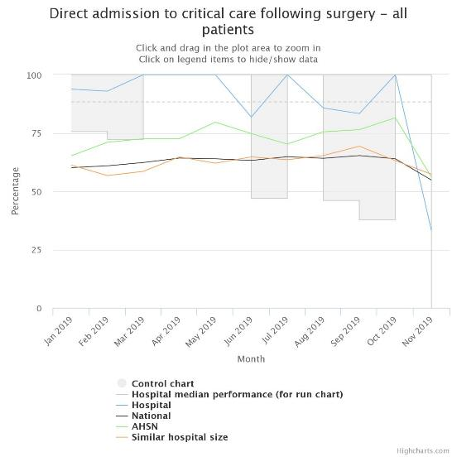
Sharing data with teams

Slide 55

Thank You
To everyone involved in caring for patients undergoing emergency laparotomy
To everyone involved in collecting the data

